Slide 1



Customer_Churn_Anlysis
View in Power BI
Last data refresh:
7/23/2025 7:55:30 AM UTC
Downloaded at:
7/23/2025 8:01:18 AM UTC

Slide 2
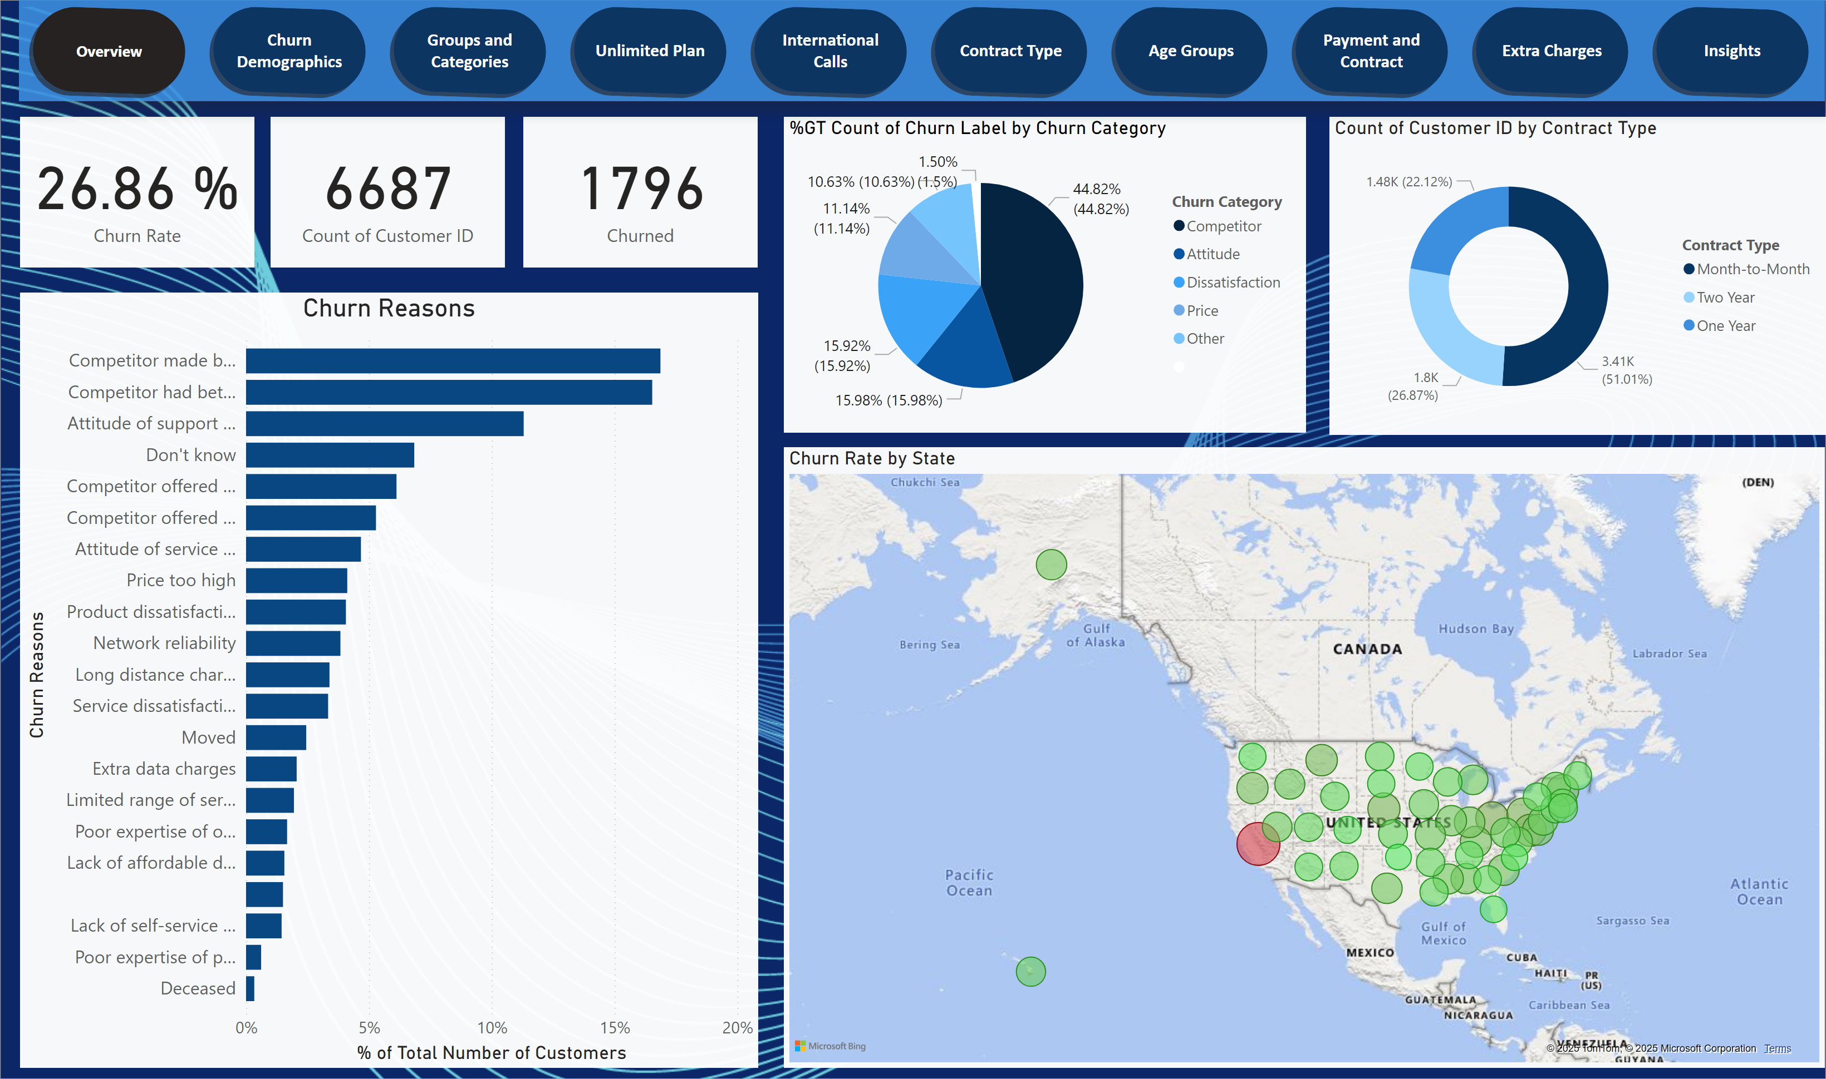
Overview
Notes:
card
No alt text provided
card
No alt text provided
card
No alt text provided
Churn Reasons
No alt text provided
donutChart
No alt text provided
pieChart
No alt text provided
map
No alt text provided
pageNavigator
No alt text provided

Slide 3
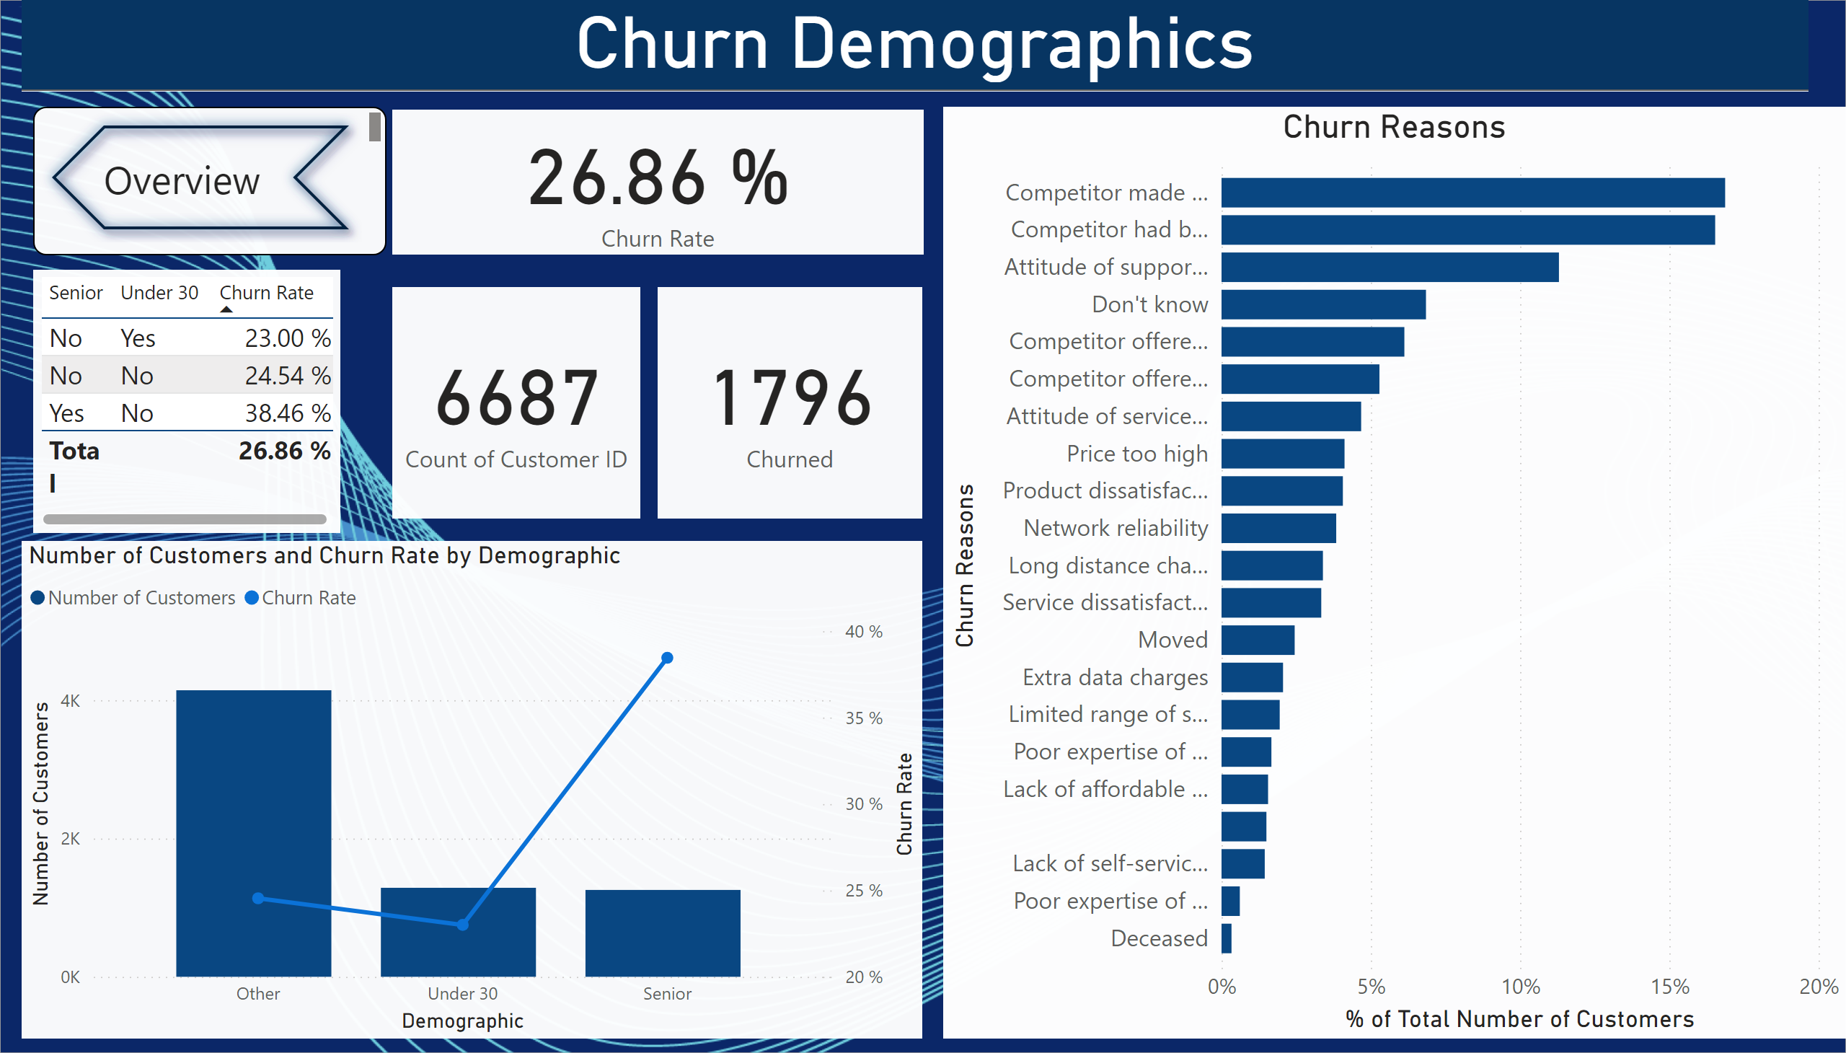
Churn Demographics
Notes:
tableEx
No alt text provided
Churn Reasons
No alt text provided
card
No alt text provided
lineStackedColumnComboChart
No alt text provided
card
No alt text provided
card
No alt text provided
Churn Demographics
No alt text provided
pageNavigator
No alt text provided

Slide 4
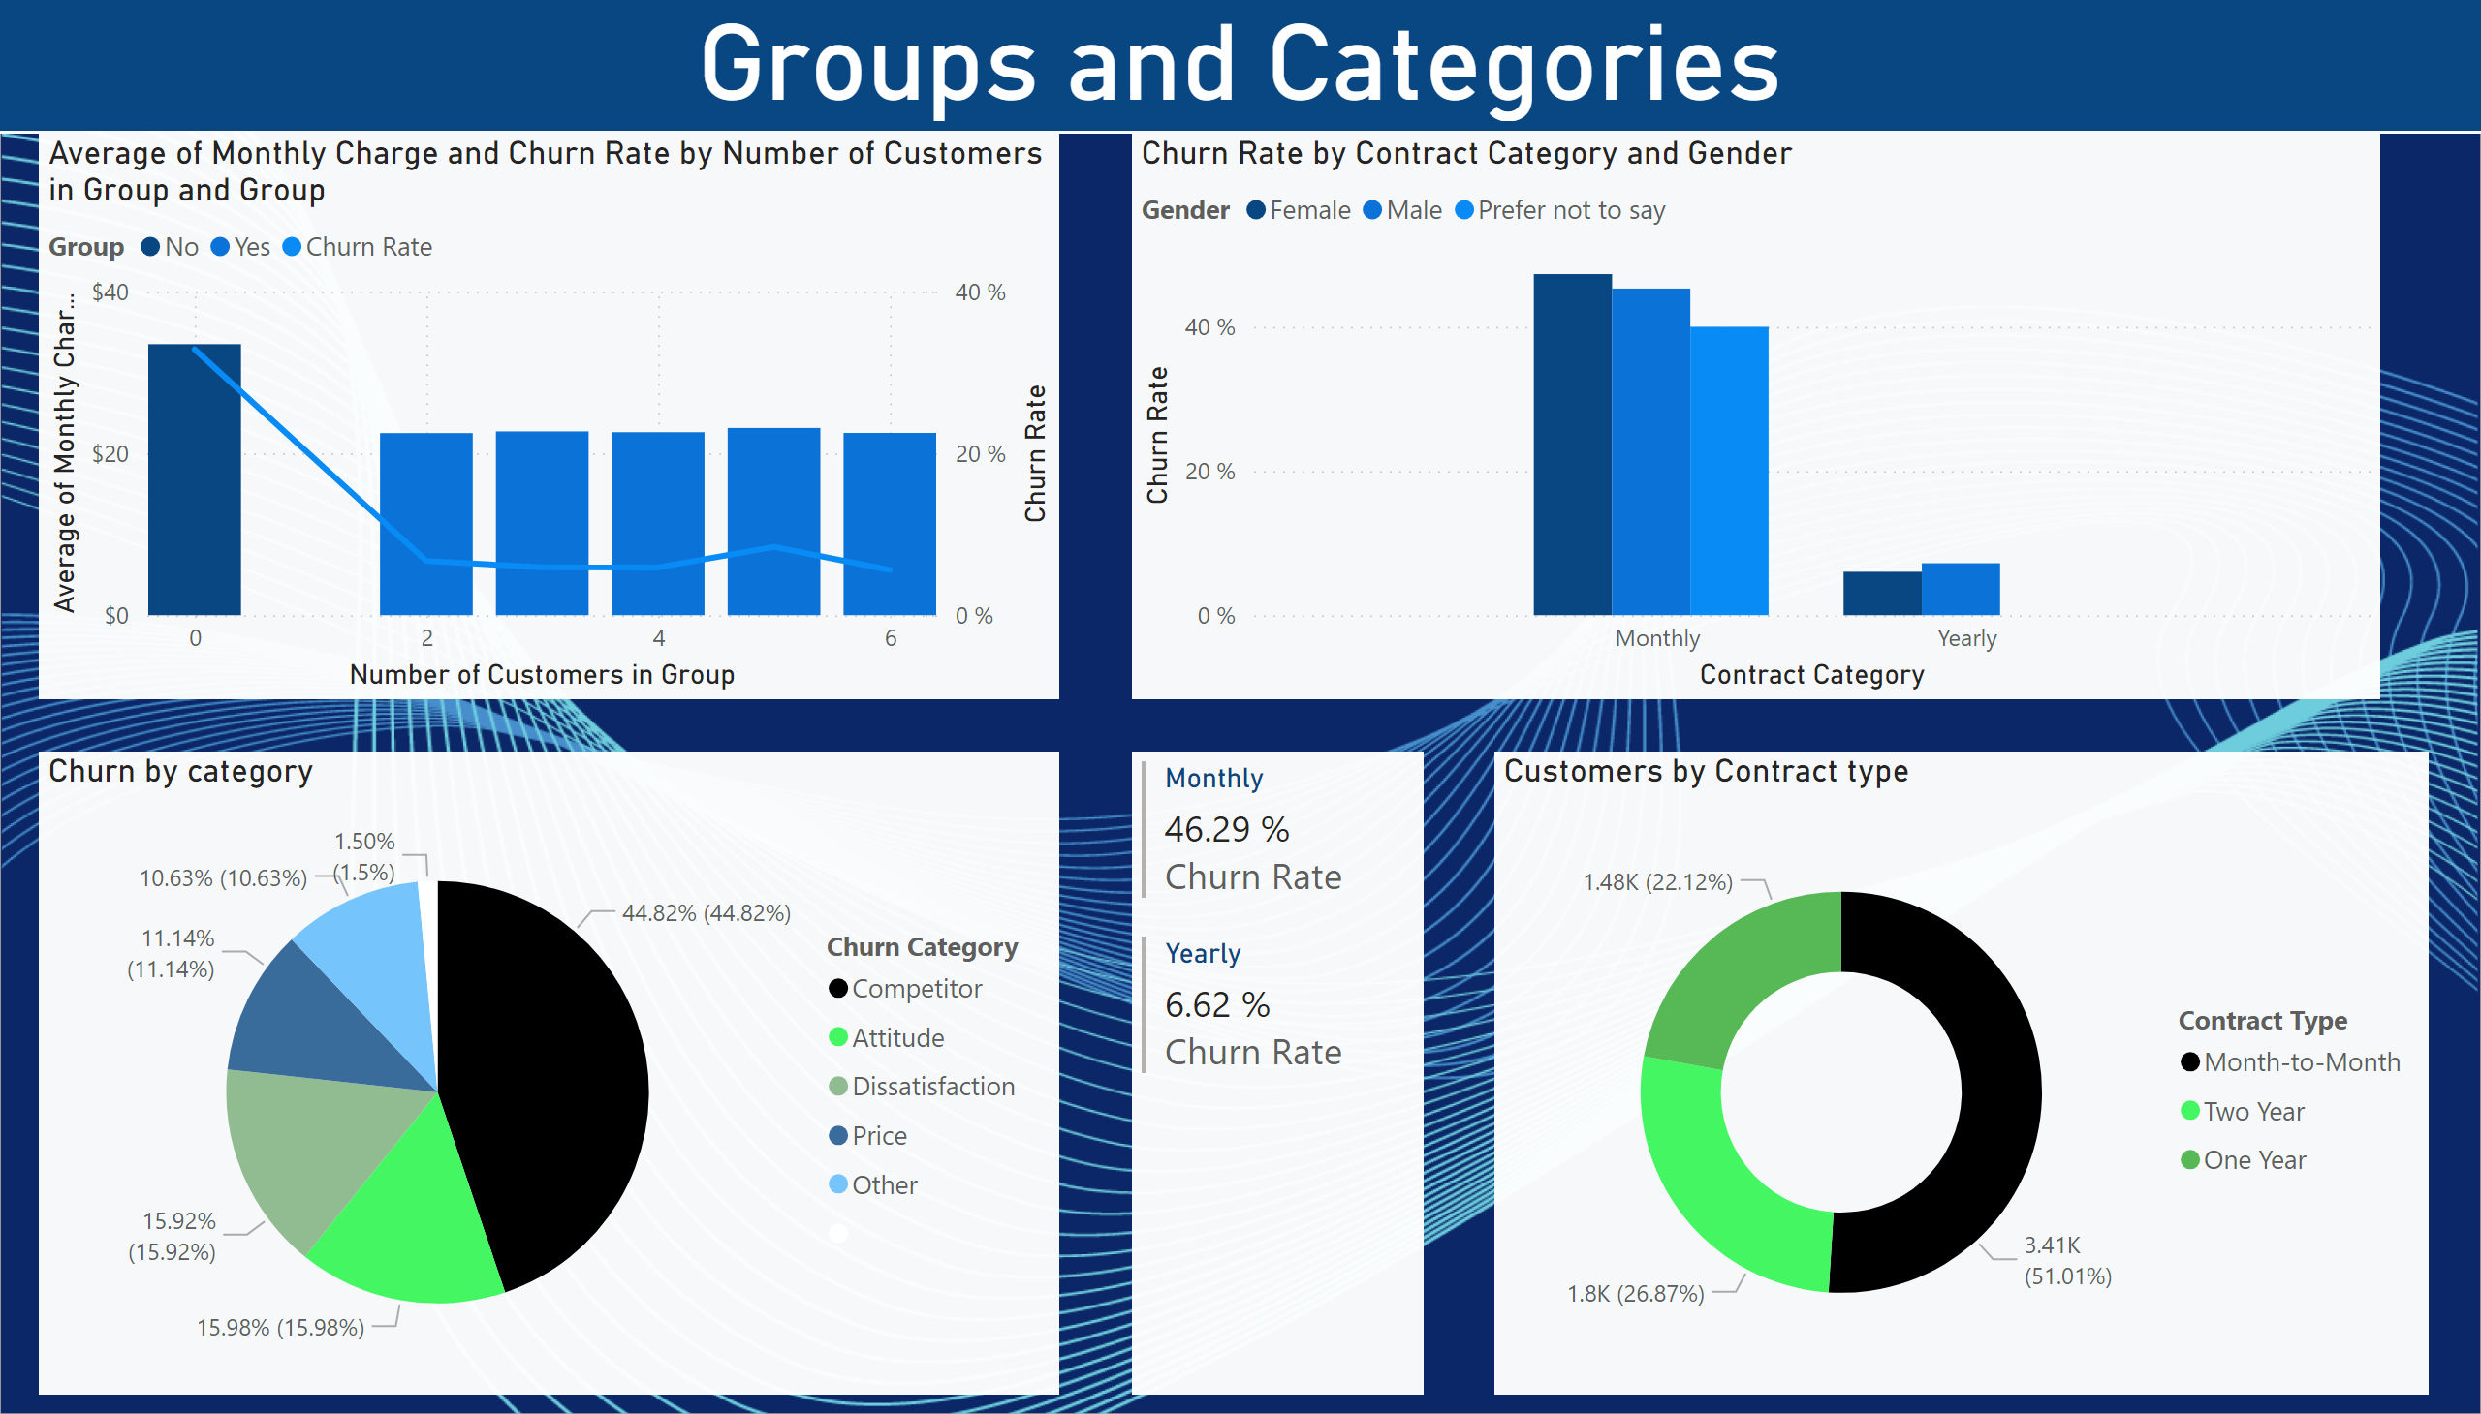
Groups and Categories
Notes:
lineStackedColumnComboChart
No alt text provided
Churn by category
No alt text provided
clusteredColumnChart
No alt text provided
multiRowCard
No alt text provided
Customers by Contract type
No alt text provided
Groups and Categories
No alt text provided

Slide 5
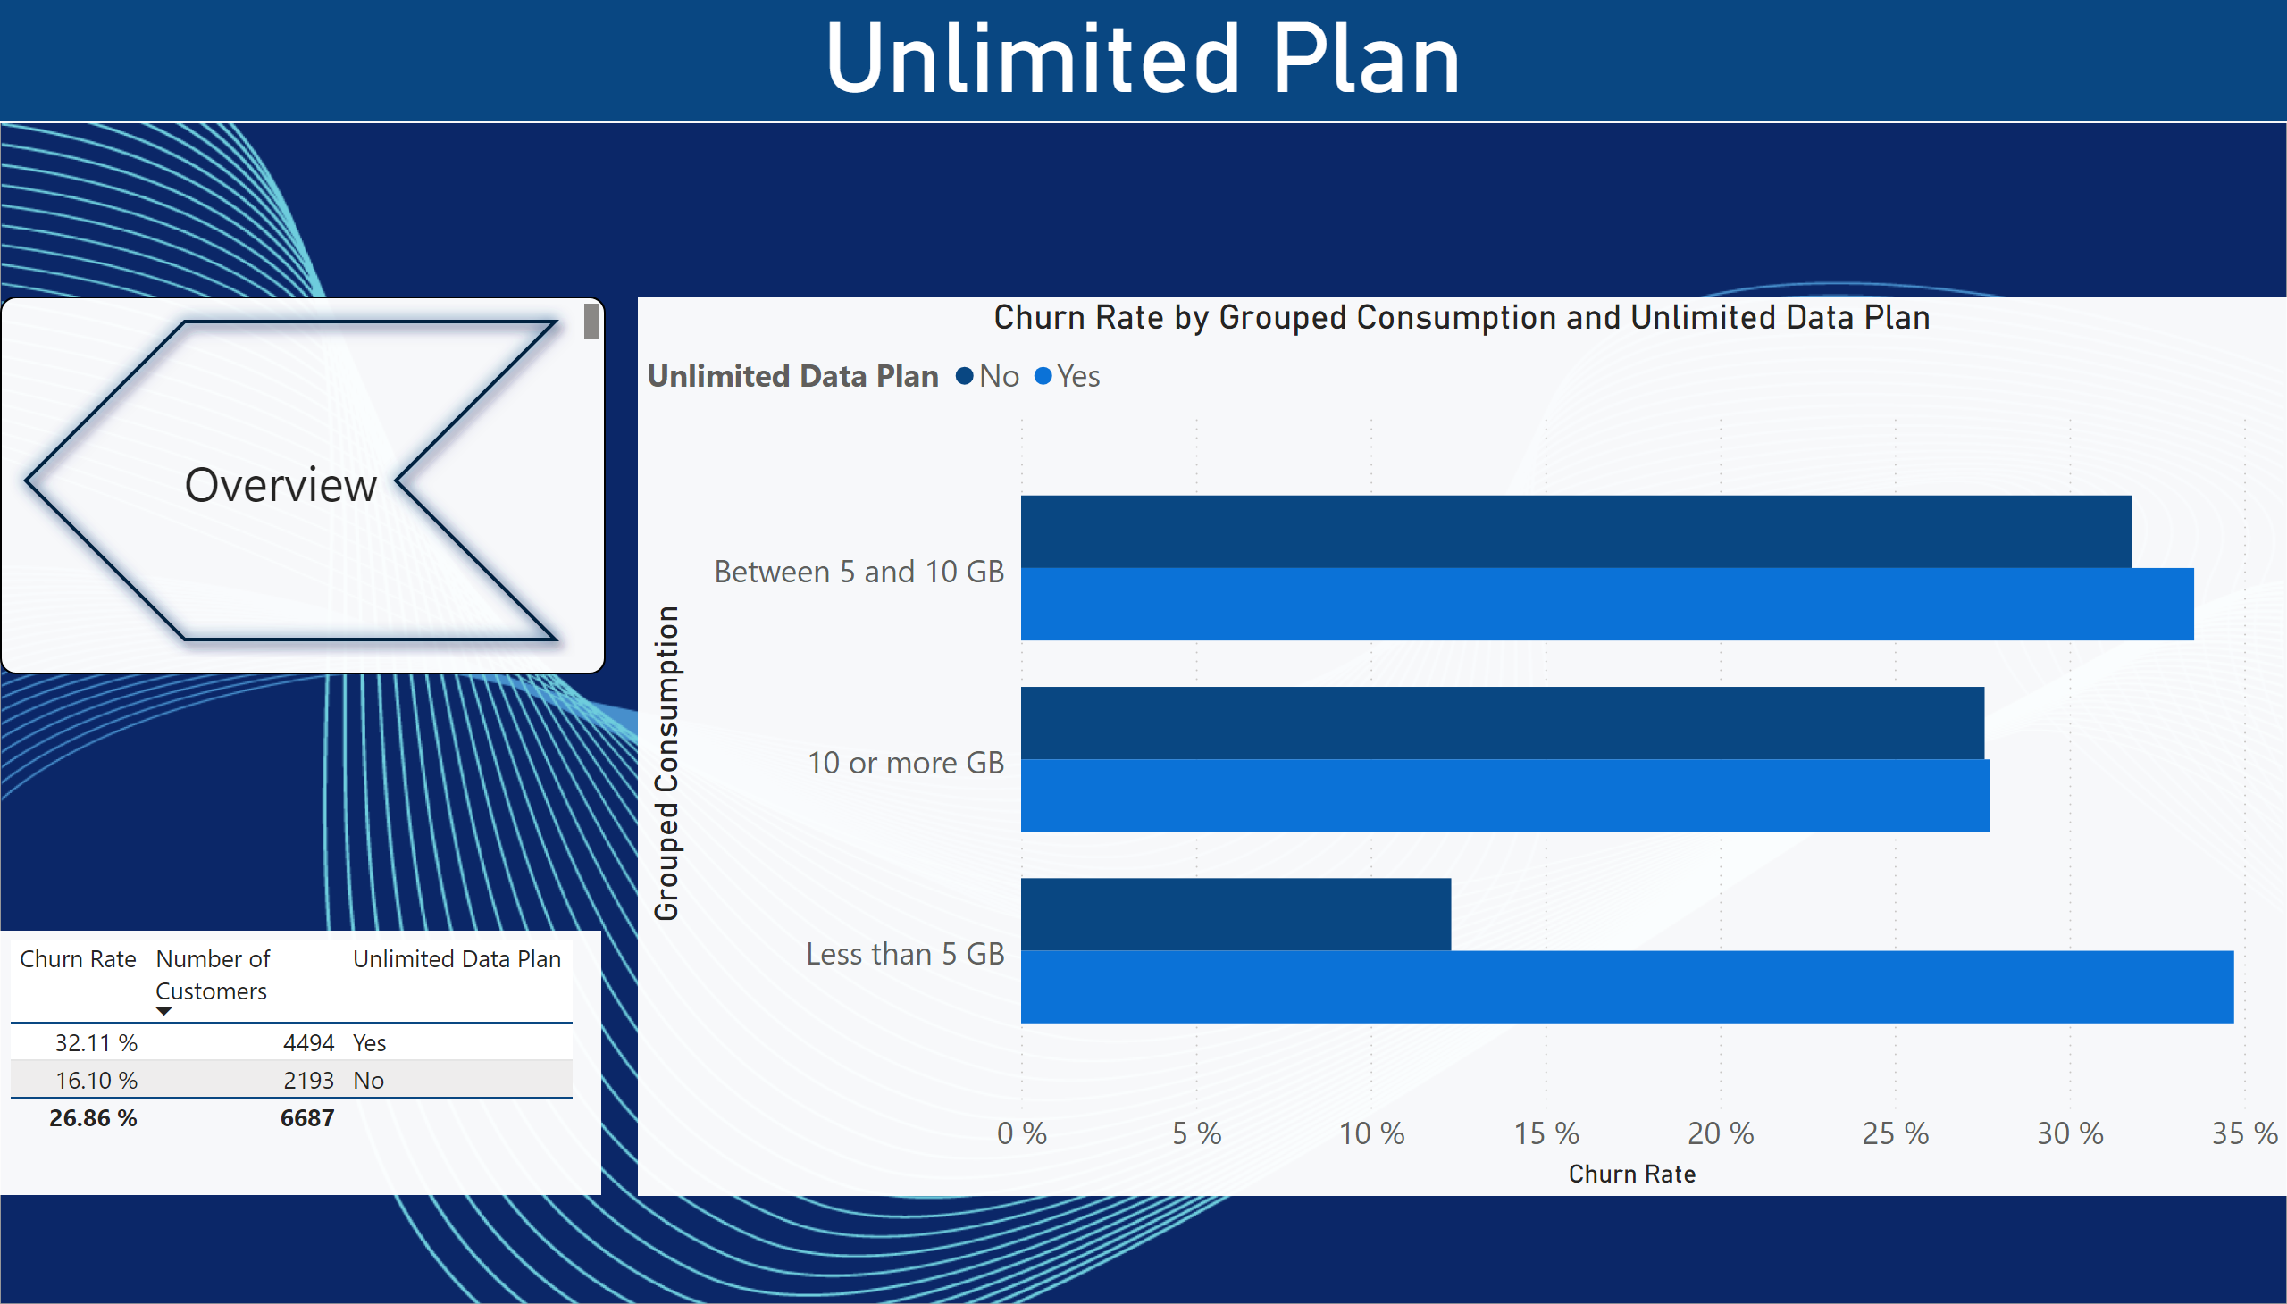
Unlimited Plan
Notes:
tableEx
No alt text provided
clusteredBarChart
No alt text provided
pageNavigator
No alt text provided
Unlimited Plan
No alt text provided

Slide 6
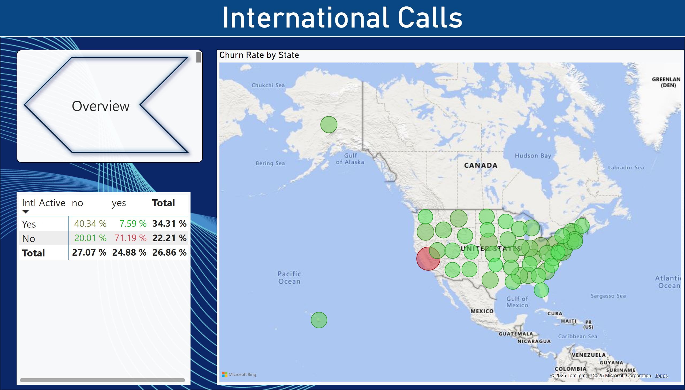
International Calls
Notes:
pivotTable
No alt text provided
map
No alt text provided
pageNavigator
No alt text provided
International Calls
No alt text provided

Slide 7
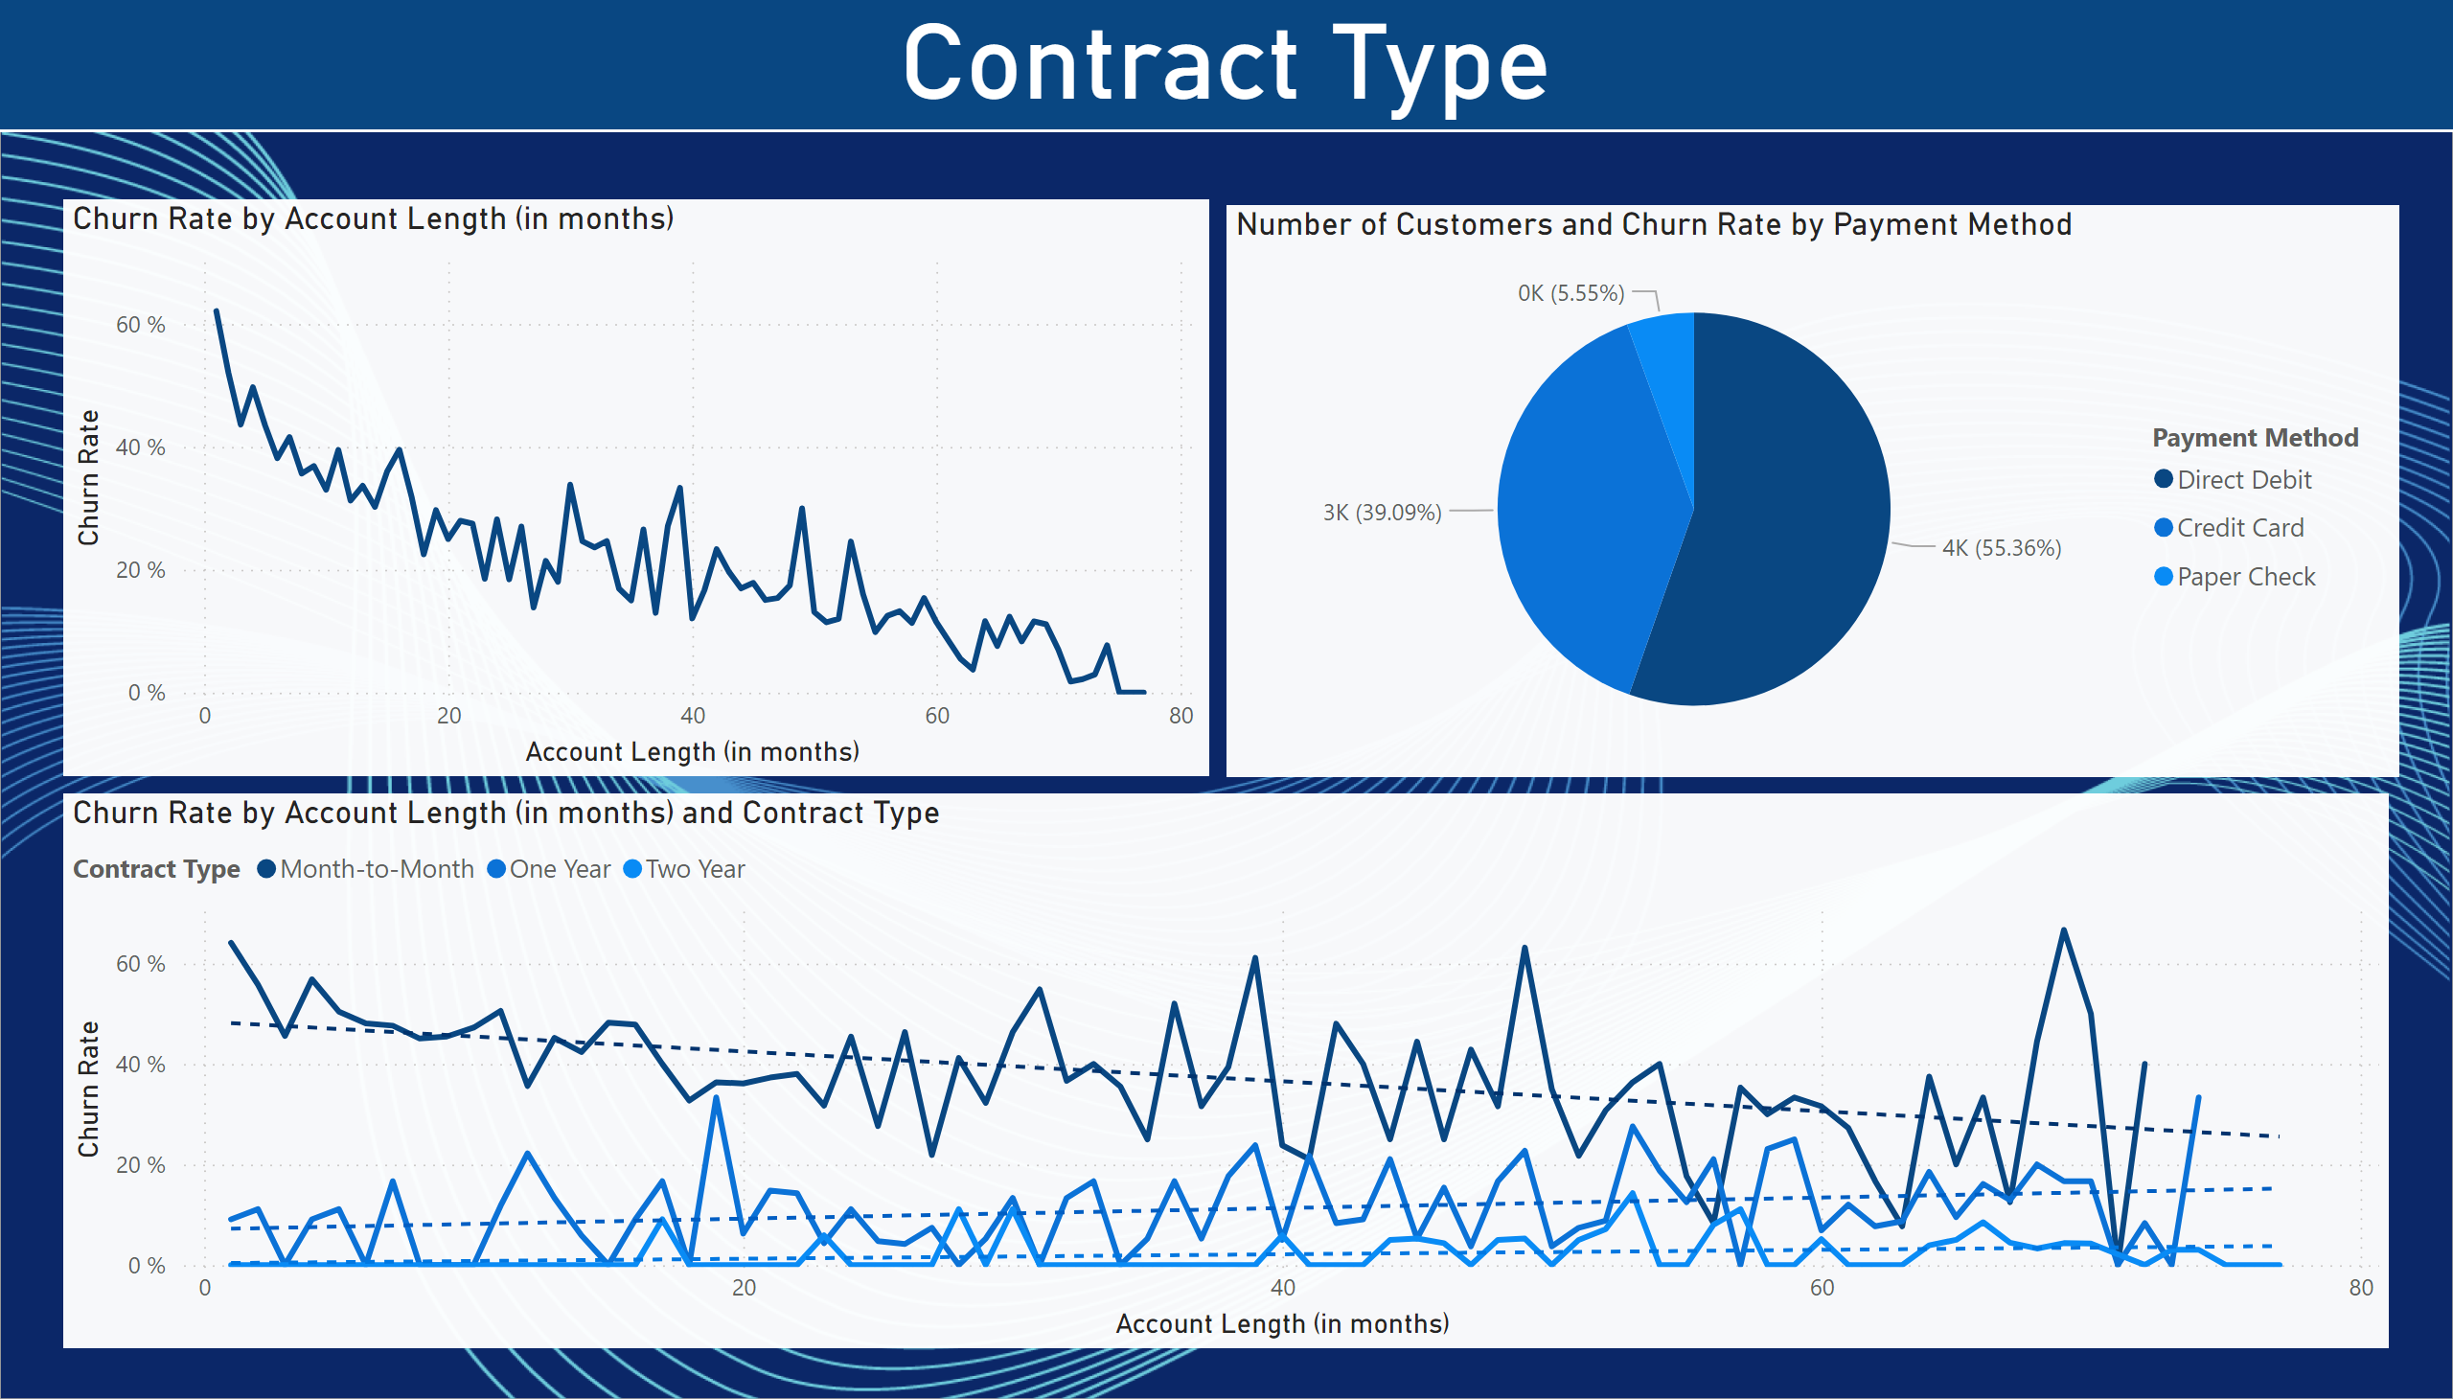
Contract Type
Notes:
pieChart
No alt text provided
lineChart
No alt text provided
lineChart
No alt text provided
Contract Type
No alt text provided

Slide 8
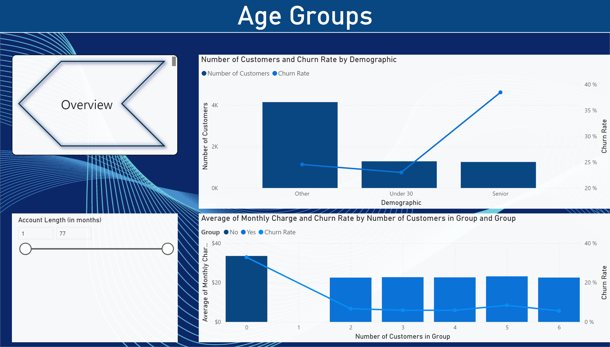
Age Groups
Notes:
lineStackedColumnComboChart
No alt text provided
slicer
No alt text provided
lineStackedColumnComboChart
No alt text provided
pageNavigator
No alt text provided
Age Groups
No alt text provided

Slide 9
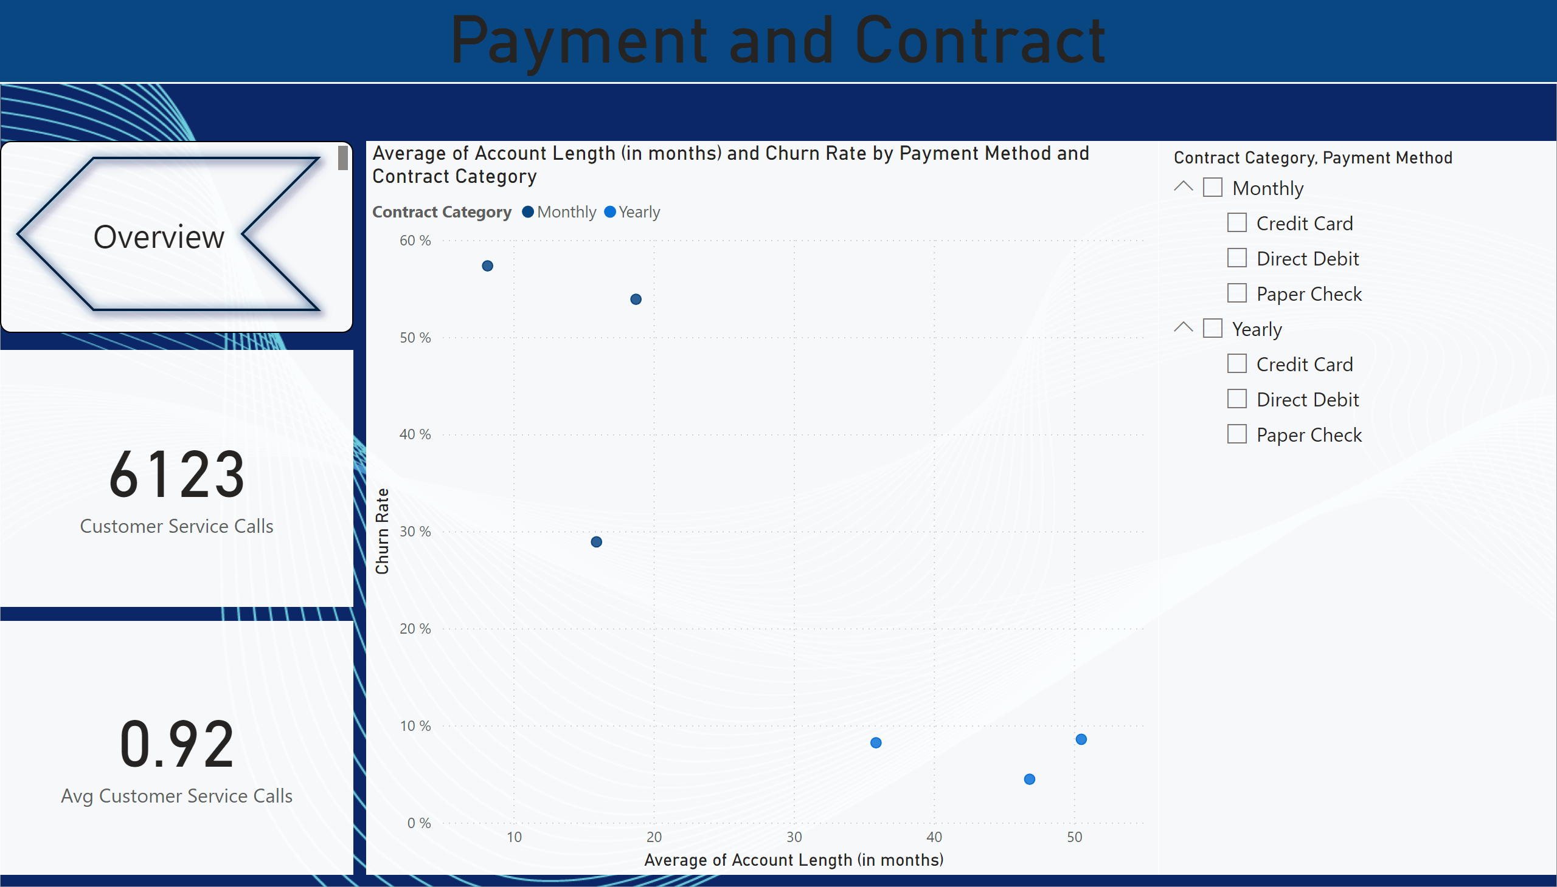
Payment and Contract
Notes:
card
No alt text provided
card
No alt text provided
scatterChart
No alt text provided
slicer
No alt text provided
Payment and Contract
No alt text provided
pageNavigator
No alt text provided

Slide 10
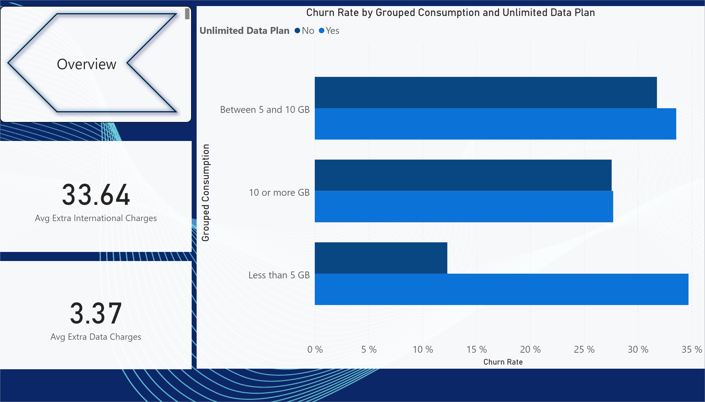
Extra Charges
Notes:
clusteredBarChart
No alt text provided
card
No alt text provided
card
No alt text provided
pageNavigator
No alt text provided

Slide 11
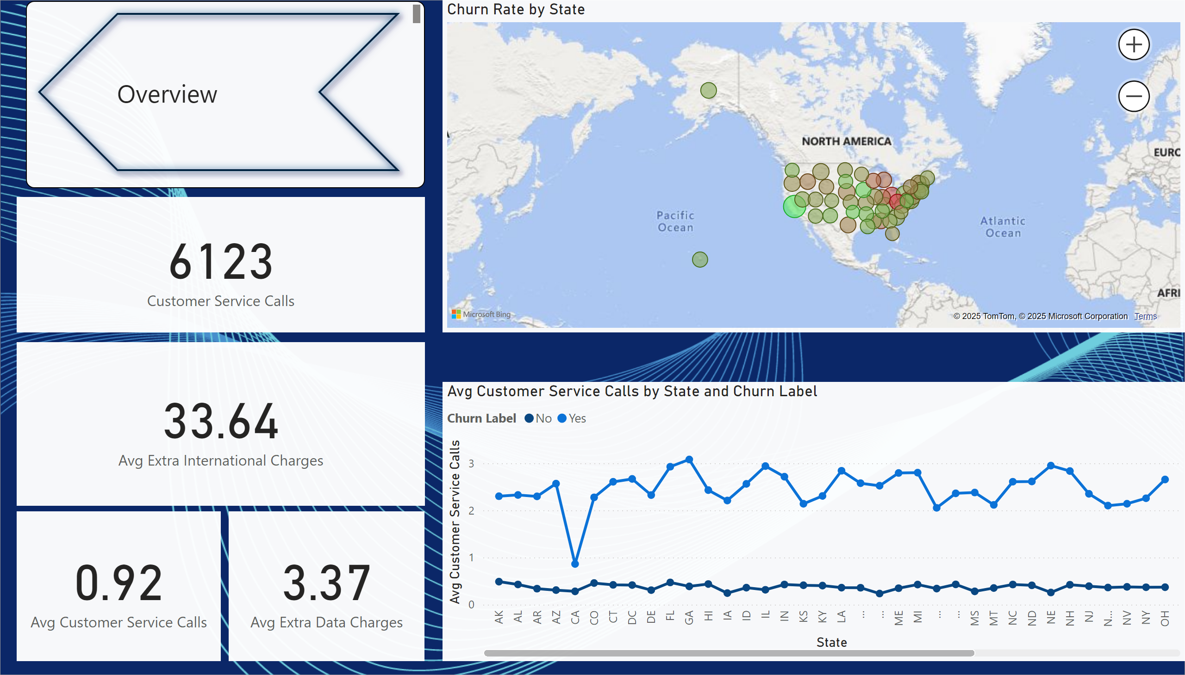
Insights
Notes:
card
No alt text provided
card
No alt text provided
card
No alt text provided
card
No alt text provided
lineChart
No alt text provided
map
No alt text provided
pageNavigator
No alt text provided

